Slide 1
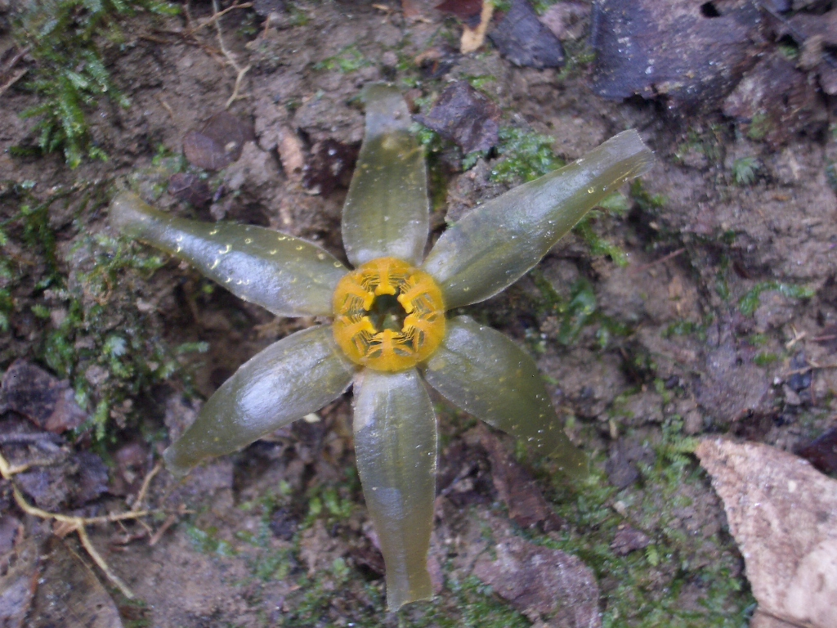
Conservation Biology & Global Change

Slide 2
Learning Goals
Identify and define three levels of biological diversity

Slide 3
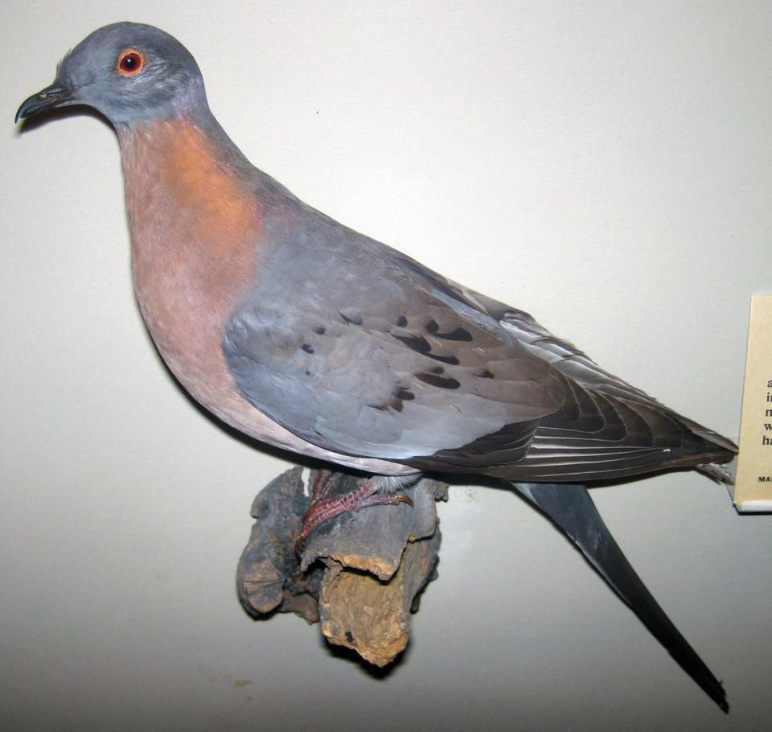
Extinction
Extinction is a natural phenomenon, but the current rate of extinction is not
Current rates 100 - 1000X times higher than normal
Current extinctions are linked to human activities

Slide 4
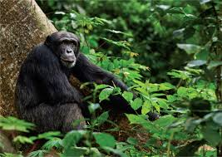
Conservation biology
The scientific basis for conserving biological diversity
Saving species
Saving ecosystems
Integrative discipline, drawing on many areas of biology and other disciplines

Slide 5
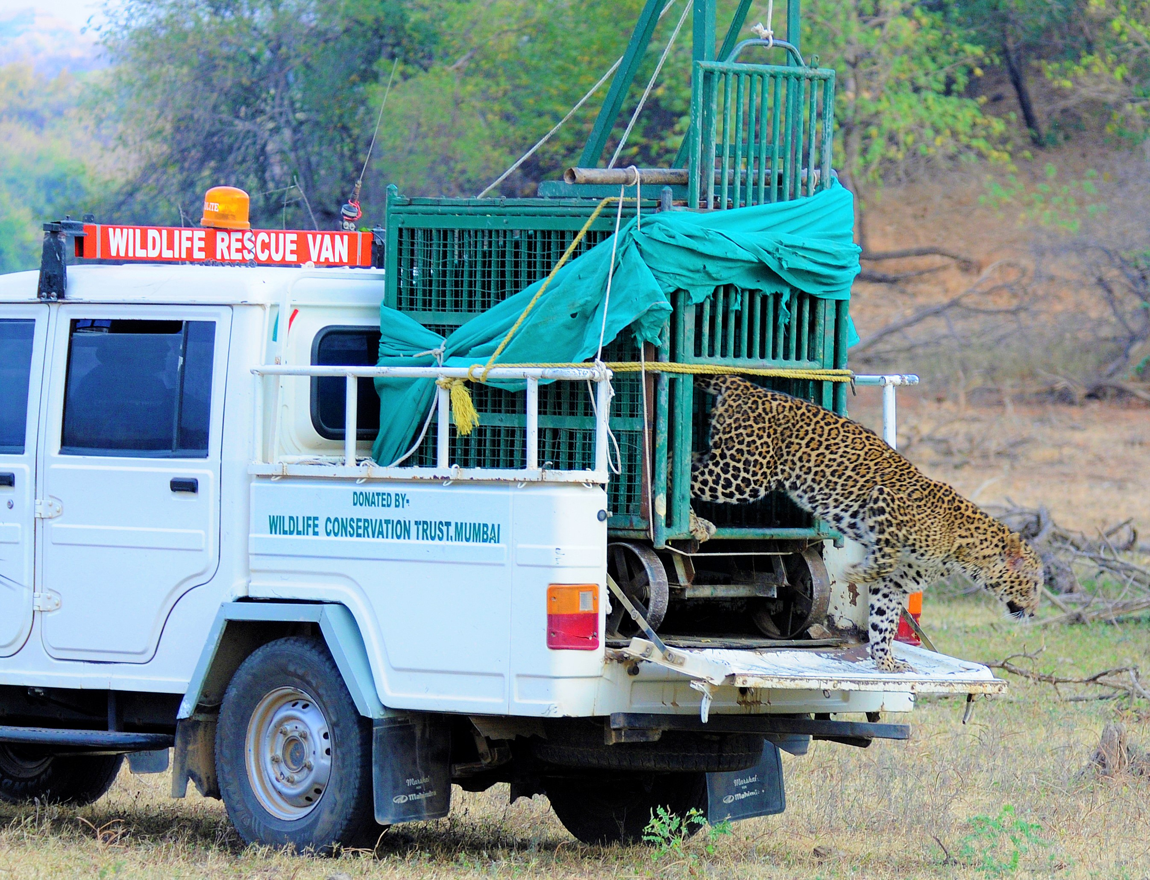
Levels of biological diversity
Genetic diversity
Species diversity
Ecosystem diversity

Slide 6
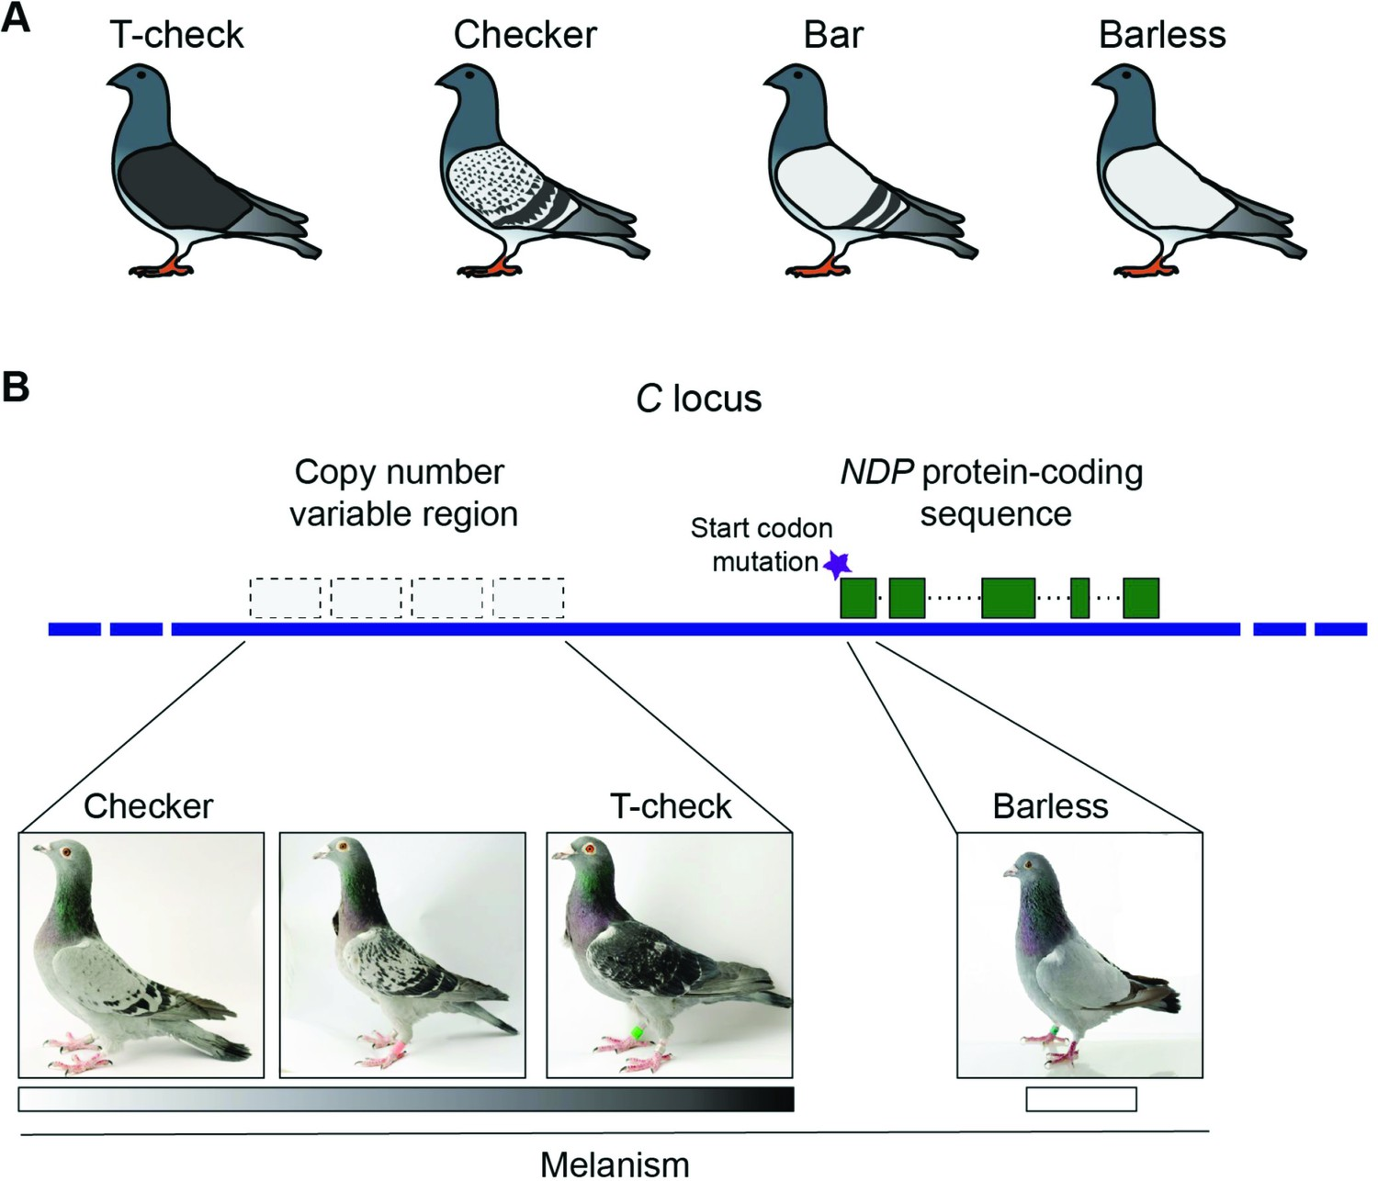
Genetic diversity
The raw material for adaptation possessed by a species
Within populations
Between populations

Slide 7
Species diversity
The number of species in the world
1.8 million described, 5-100 million undescribed
The discovery of Tiputinia foetida in Ecuador

Slide 8
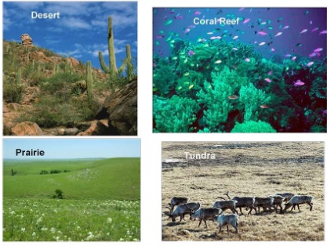
Ecosystem diversity
The variety of habitat conditions on Earth
Emphasis is on both on habitats and species interactions in those habitats

Slide 9
Conservation Biology & Global Change

Slide 10
Learning Goals
Explain ways in which biological diversity enhances the quality of life for people

Slide 11
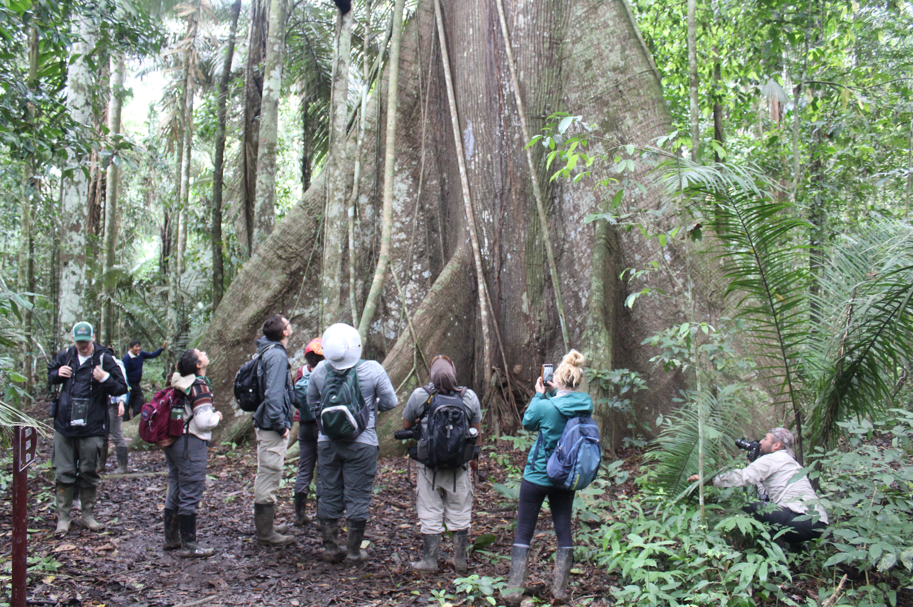

Slide 12
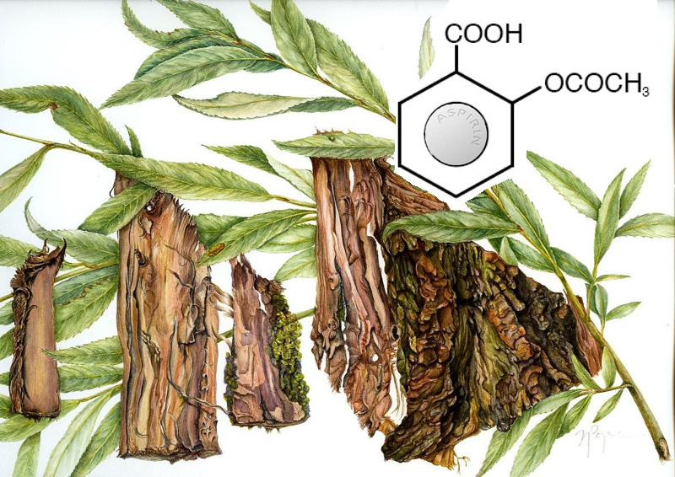
Benefits of species diversity
Wild species provide medicines, food, and industrial products
Rubber
Aspirin
Antibiotics
Prescription drugs

Slide 13
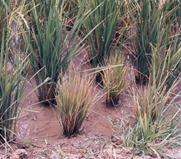
Benefits of genetic diversity
Wild relatives of domesticated plants have valuable genetic material that can be bred into commercial plants
Resistance to rice grassy stunt virus

Slide 14
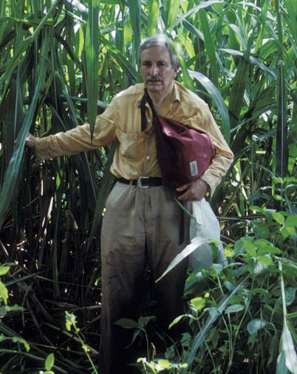
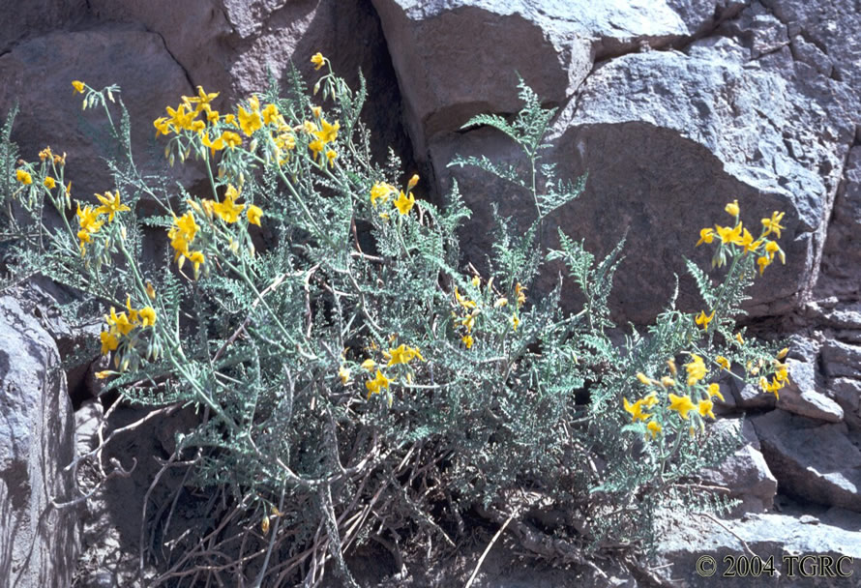
Benefits of genetic diversity
What good are weedy tomatoes?
During an expedition in Peru to discover new species, Dr. Hugh Iltis discovered a wild relative of a tomato
When crossed with domestic tomatoes, it increased sugar content, leading to a $60 million/yr benefit to tomato growers

Slide 15
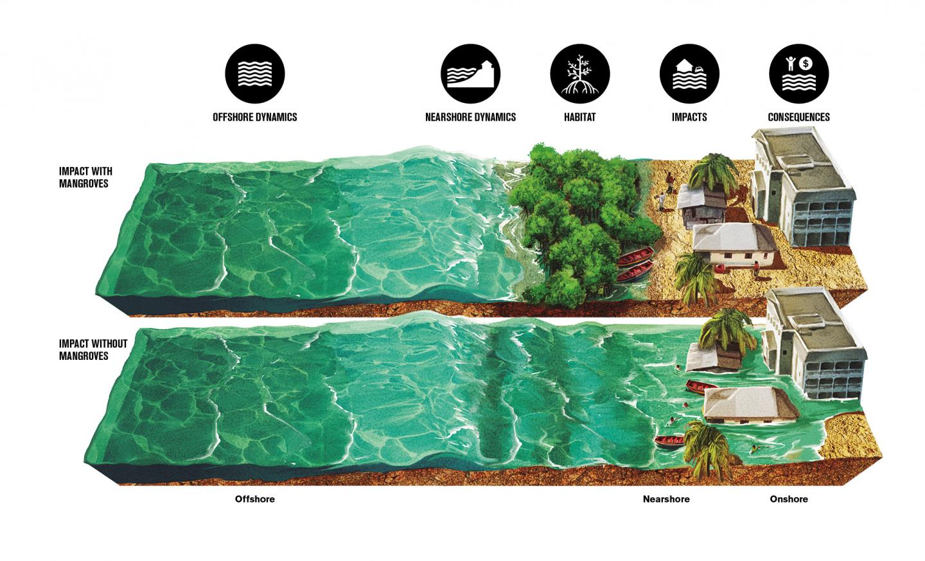
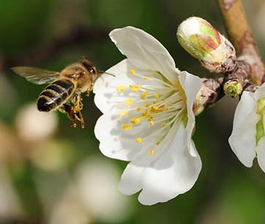
Ecosystem services
Ecosystem services - the processes through which natural ecosystems sustain human life
Environmental detoxification
Flood control
Pollination, pest control
Soil fertility, oxygen production

Slide 16
Conservation Biology & Global Change

Slide 17
Learning Goals
Identify the major threats to biological diversity

Slide 18
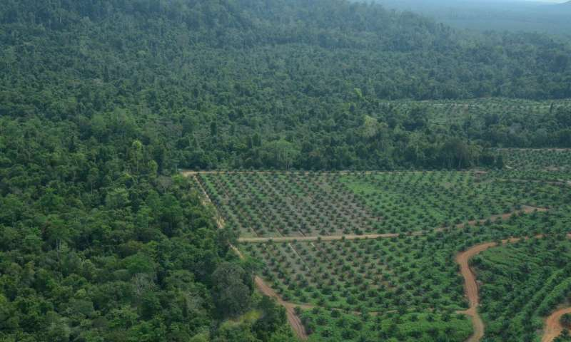
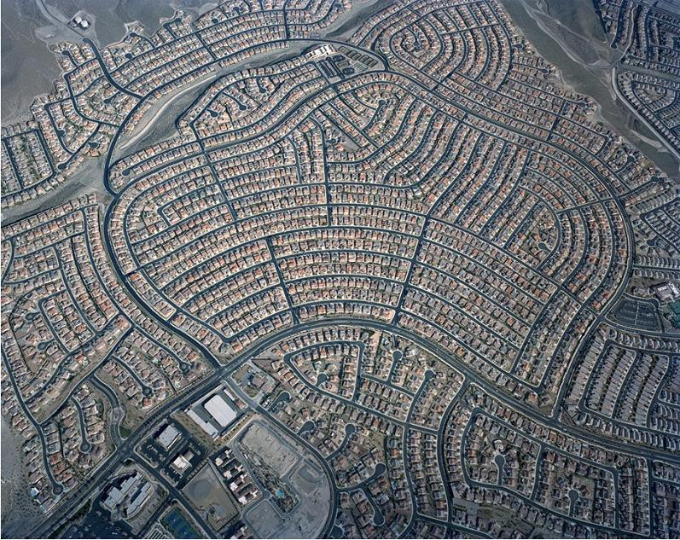
Habitat destruction
The conversion of wild habitats to farms, strip mines, cities and developments, draining and filling wetlands
Primary or contributing cause to 73% of all species that became extinct or endangered

Slide 19
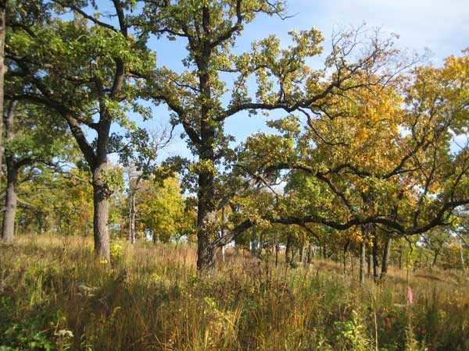
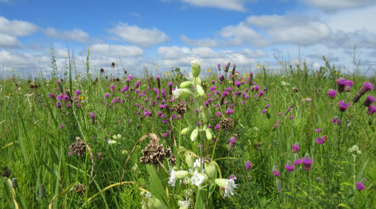
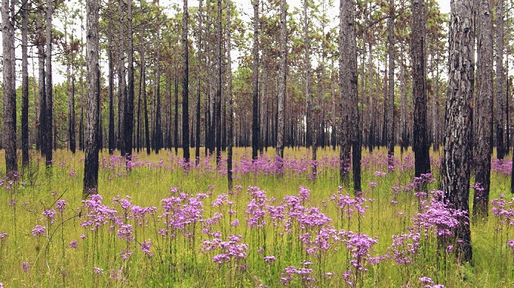

Slide 20
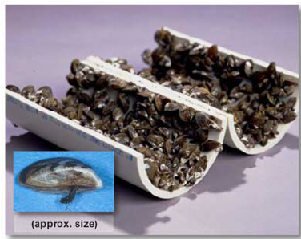
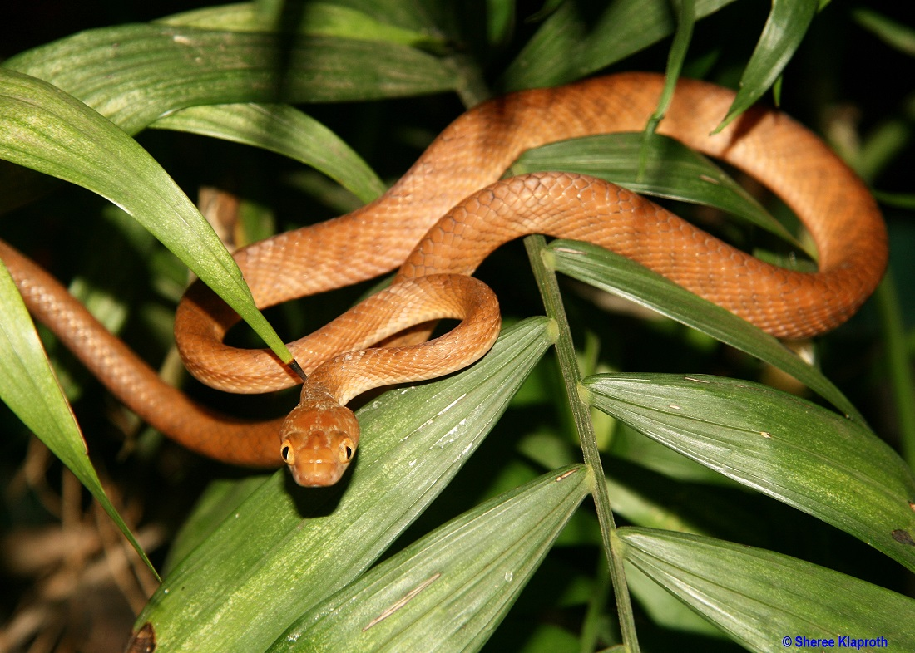
Introduced species
Species moved by people intentionally or accidentally to new geographic regions
Invasive species - cause damage to the environment, the economy, or the health of people or domesticated species
Examples: zebra mussel, brown tree snake

Slide 21
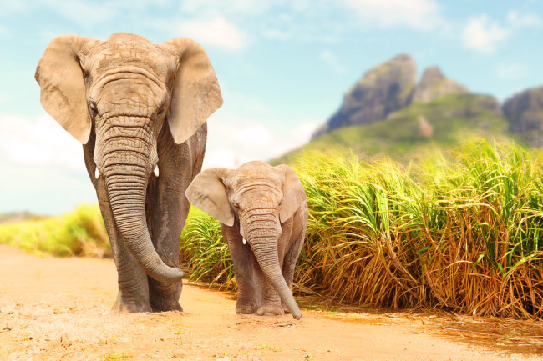
Overharvesting
The harvesting of wild organisms at a rate that exceeds sustainable harvest
Species with long generation times or small population sizes are among the most vulnerable

Slide 22
Extinct Due to Overharvesting: Passenger Pigeon

Slide 23
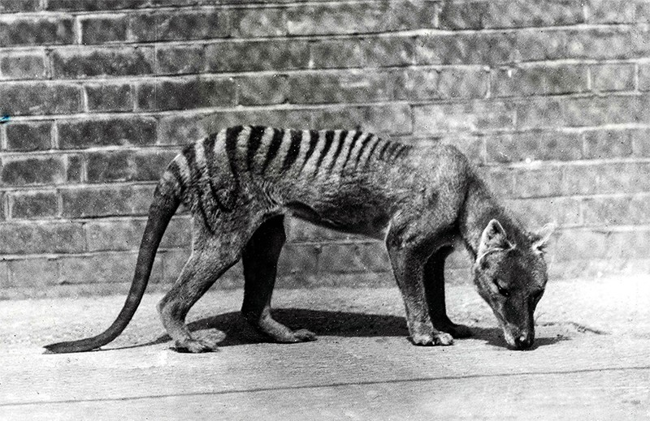
Extinct Due to Overharvesting: Tasmanian tiger

Slide 24
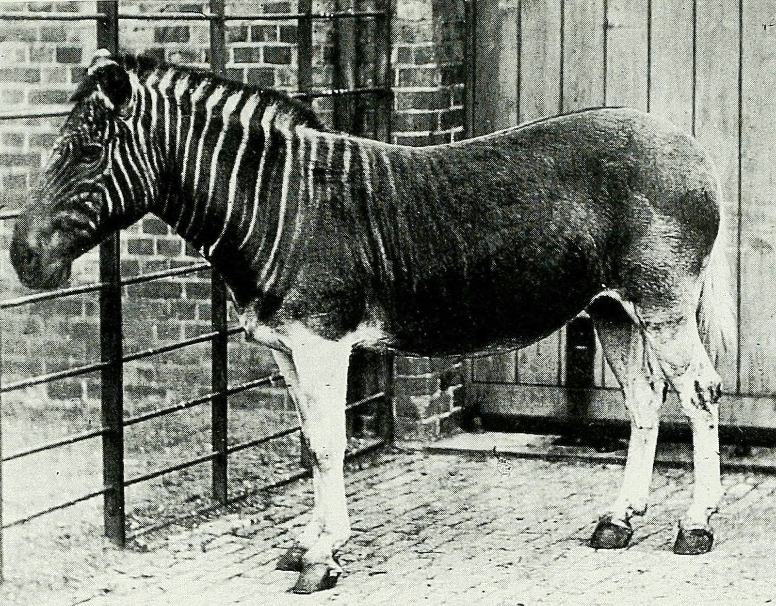
Extinct Due to Overharvesting:
Quagga

Slide 25
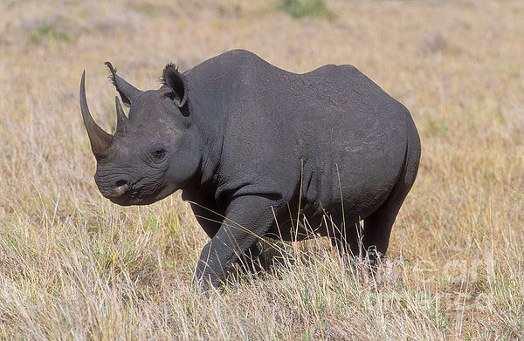
Extinct Due to Overharvesting: West African Black Rhino

Slide 26
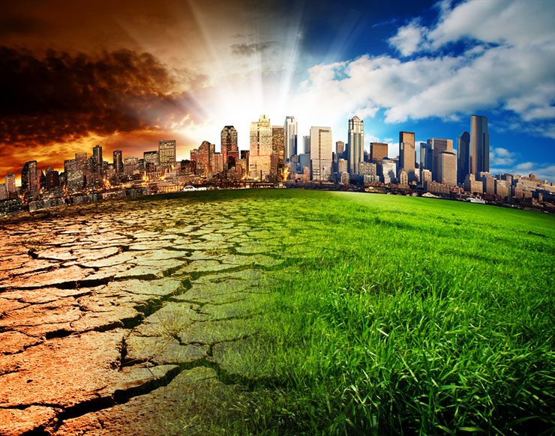
Global change
Alteration of the Earth’s ecosystems at a global scale
climate
atmospheric chemistry
biogeochemical cycles

Slide 27
Conservation Biology & Global Change

Slide 28
Learning Goals
Explain the biodiversity hotspot concept and why it can help guide conservation efforts

Slide 29
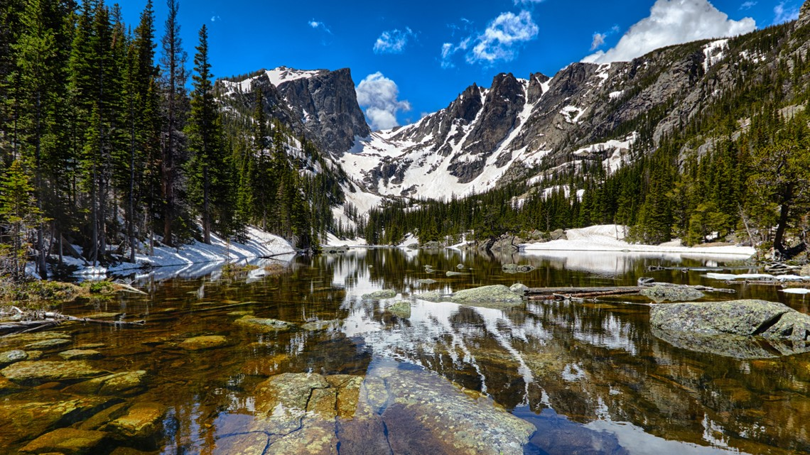
Establishing protected areas
About 7% of the Earth’s land has some degree of protection
Are protected areas in the right place for conserving biological diversity?

Slide 30
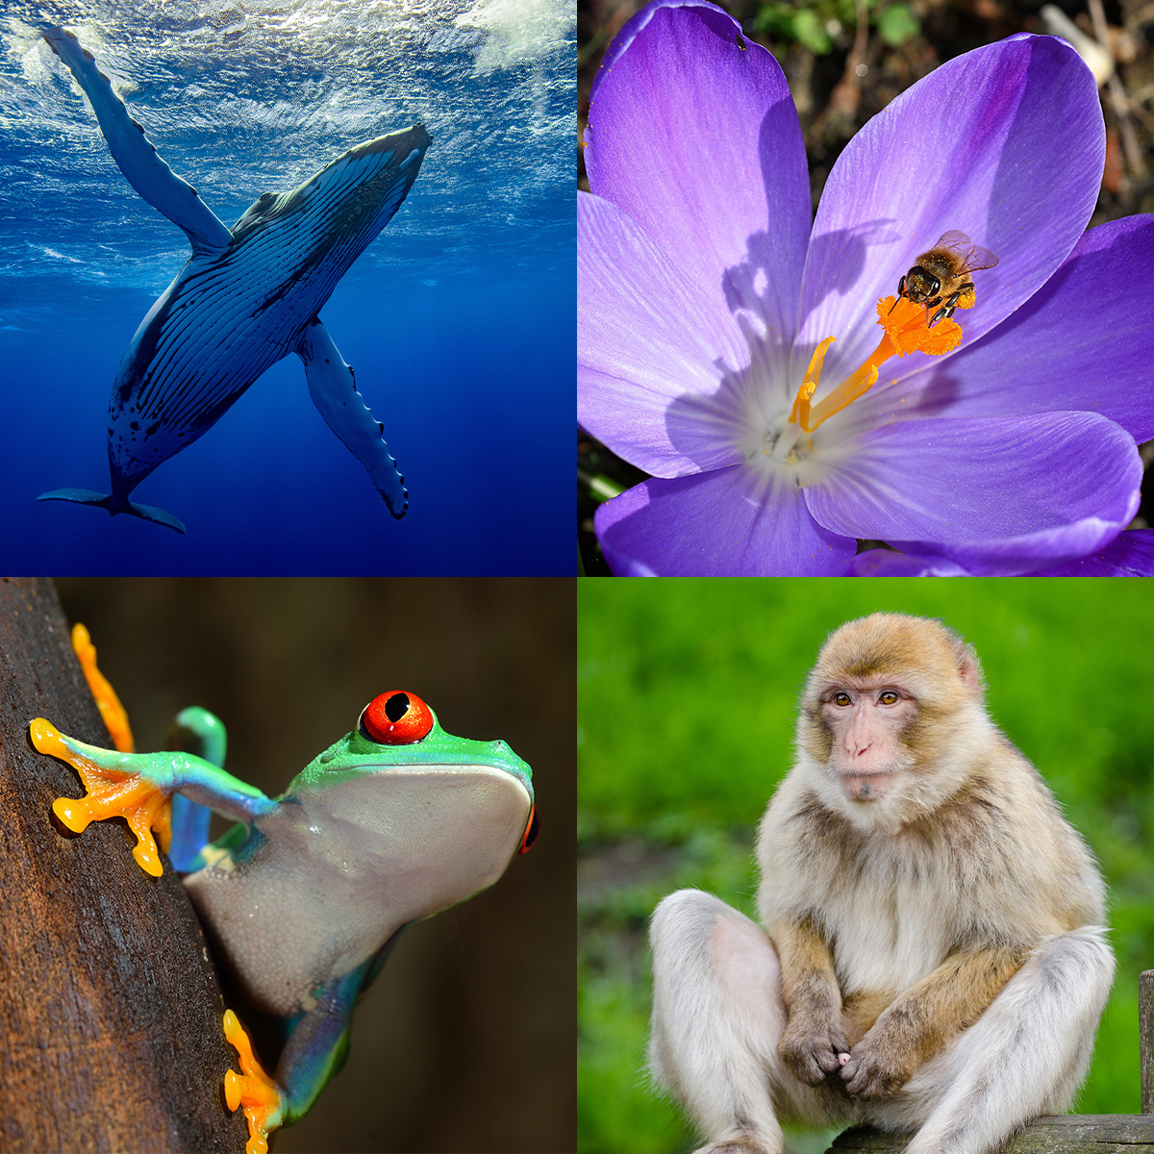
Biodiversity hotspots
Biodiversity Hotspots - areas of highest conservation priority
Endemism - species found nowhere else in the world
Nearly 30% of all bird species are found in hotspots that make up 2% of the Earth’s land area

Slide 31
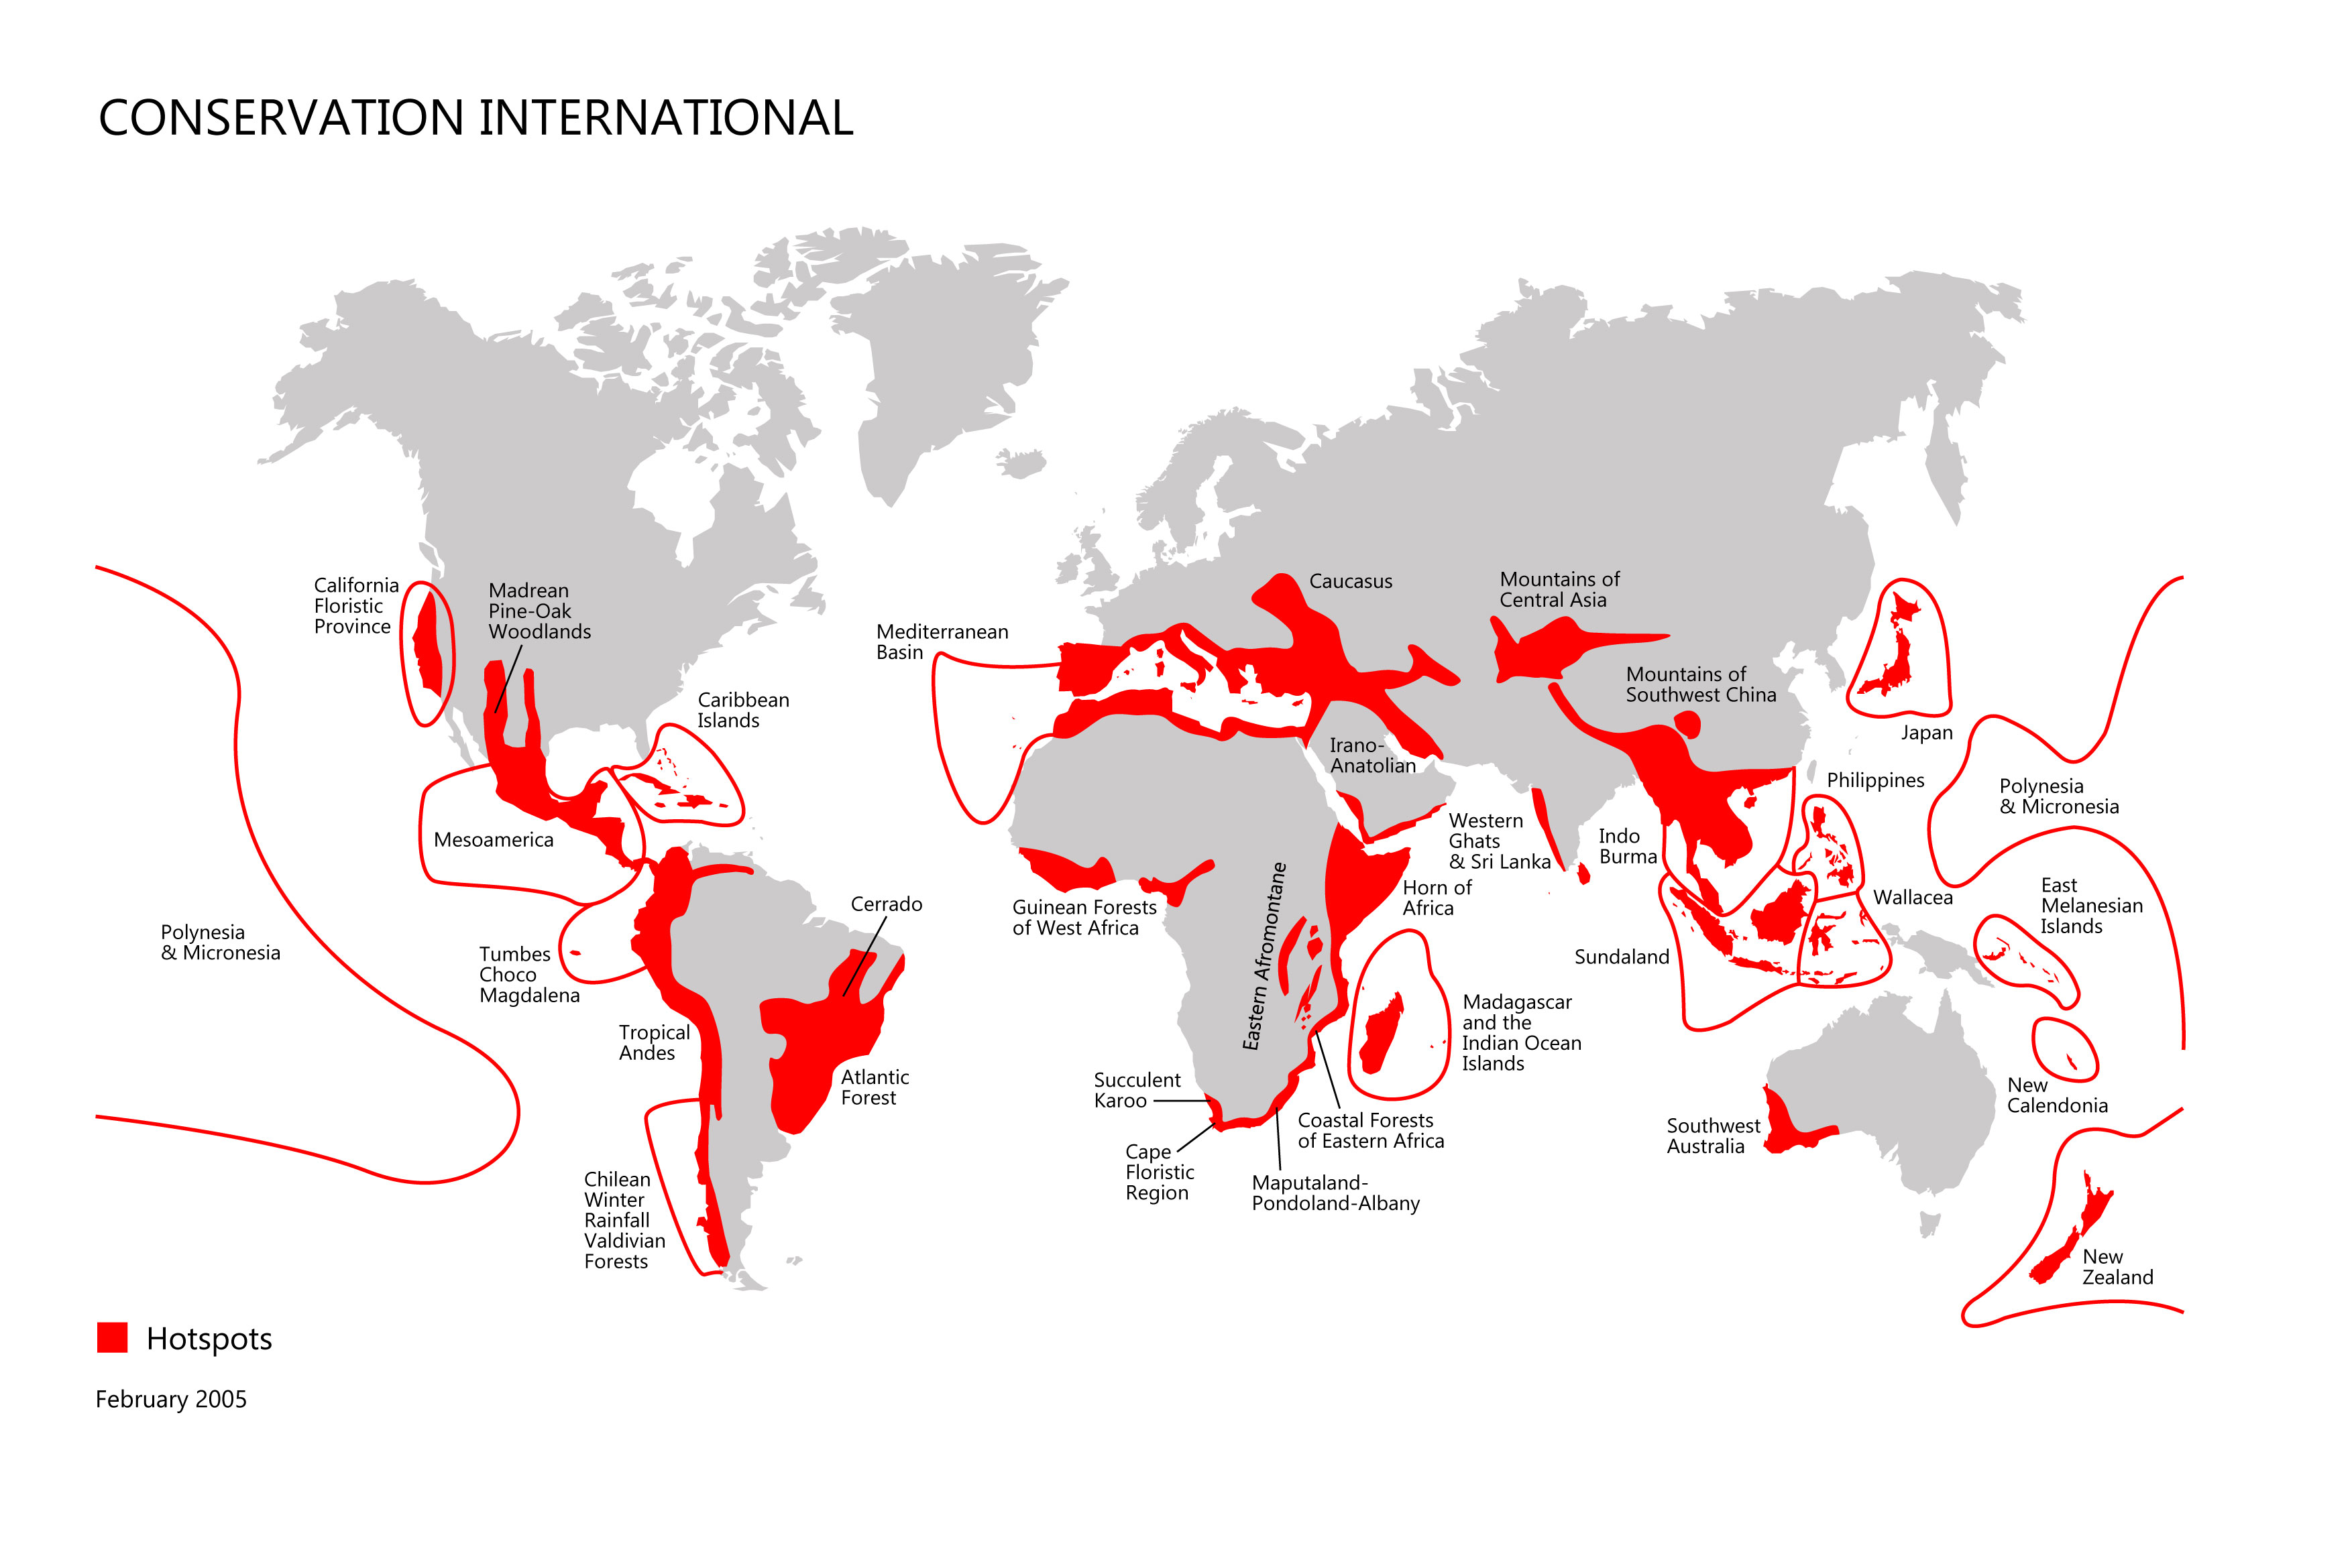
Global location of biodiversity hotspots

Slide 32
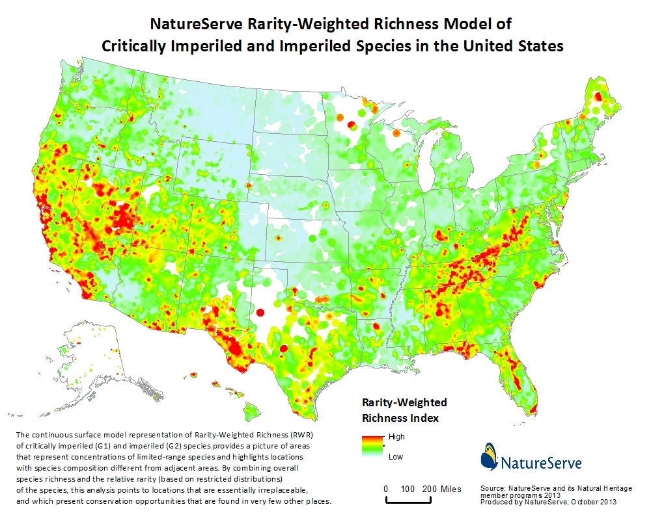
Biodiversity hotspots in the USA

Slide 33
Conservation Biology & Global Change

Slide 34
Learning Goals
Identify three types of global change that affect biological diversity
Define sustainable development

Slide 35
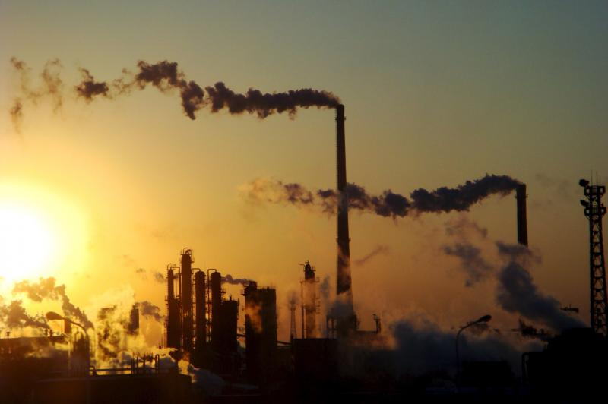
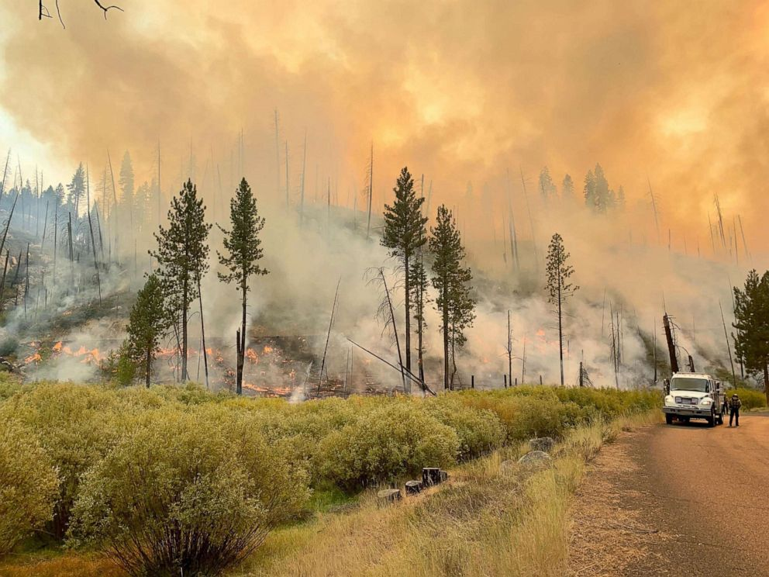
Climate change
Human activities release greenhouse gasses like CO2 into the atmosphere
Rising CO2 increases global temperature
Effects patterns of rainfall, wind patterns, (probably) storm severity
Increases wildfires, disease outbreaks, droughts, floods, all affecting humans and biological diversity

Slide 36
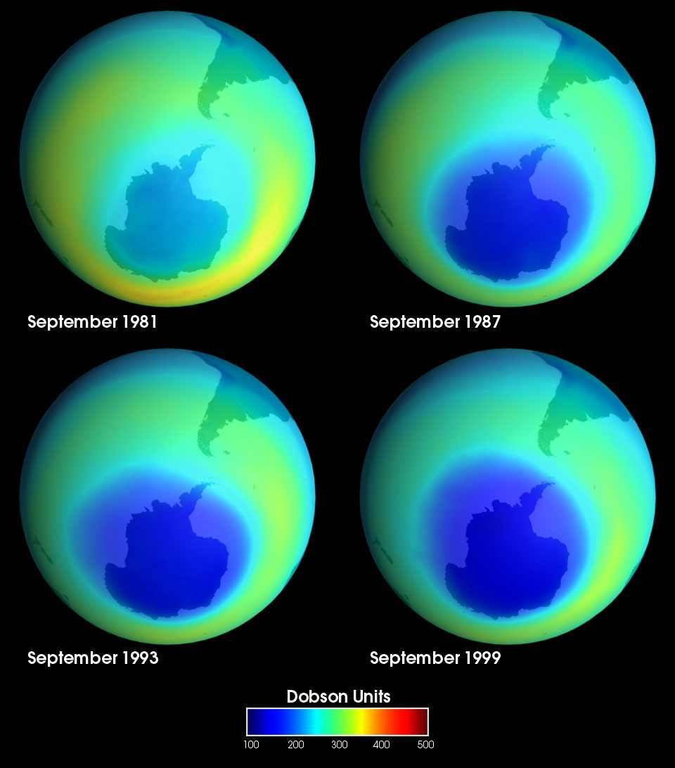
Changes in atmospheric chemistry: ozone depletion
Life on Earth is protected by a thin layer of ozone about 20 km above the Earth’s surface
Small group of industrial chemicals developed in the 1930s turned out to react with and degrade ozone. They were ultimately banned.
Two lessons from ozone depletion

Slide 37
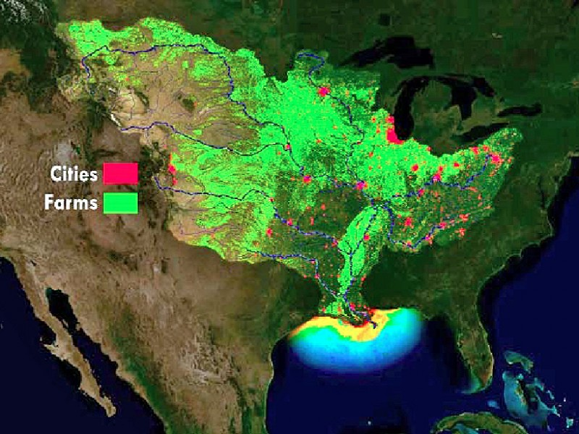
Altered biogeochemical cycles
Nutrients from fertilized soils can run off into streams, lakes, rivers, the ocean
Critical load - amount of nutrient that can be absorbed by plants
Dead zone - coastal marine environments with no oxygen

Slide 38
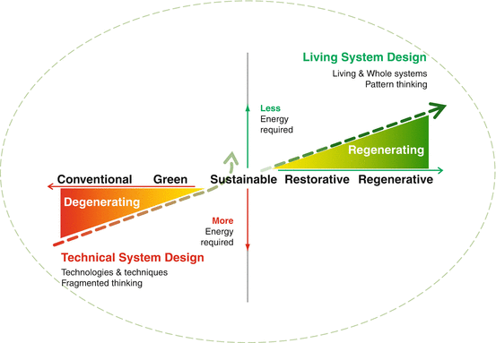
Sustainability
Sustainable development - meeting the needs of people today without limiting the ability of future generation to meet their needs

